Slide 1
Car Information Management System

Slide 2

AGENDA:
Introduction
Objective
Actors
Use Case Diagrams
Sequence Diagrams
Output Snippets
Validations
Exceptions

Slide 3
Introduction
What is CIMS?
A system designed to manage and view detailed information about cars.
Helps administrators perform various operations on car data.

Slide 4
ACTORS:
Administrator:
Create Car
Edit Car
Delete Car
List Car
View Car List by Manufacturer and Type
Customer:
List all Car Details
View Car List by Manufacturer, Type and Transmission

Slide 5

Objective :
To enable administrators to:
Add, update, delete, and List car details.
View car details based on specific criteria
(Ex : Manufacturer, Type….)
To provide customers with:
The ability to search and view car details based on specific criteria

Slide 6
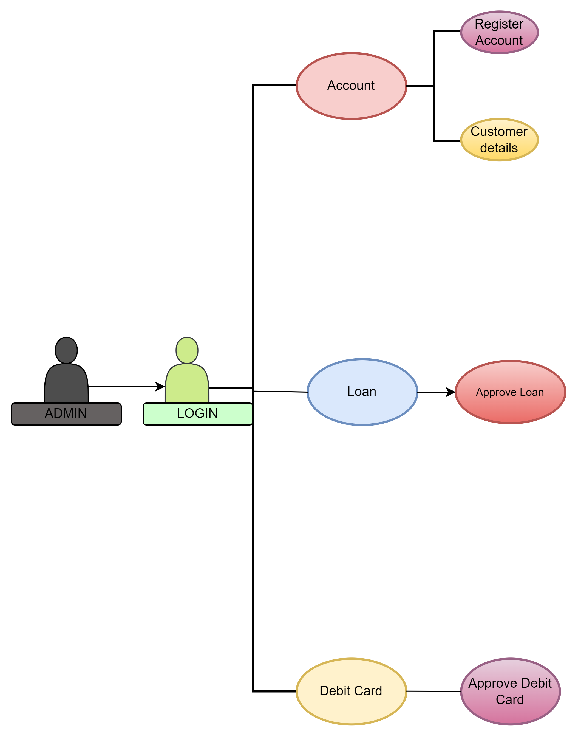
Use Case Diagram (admin):

Slide 7
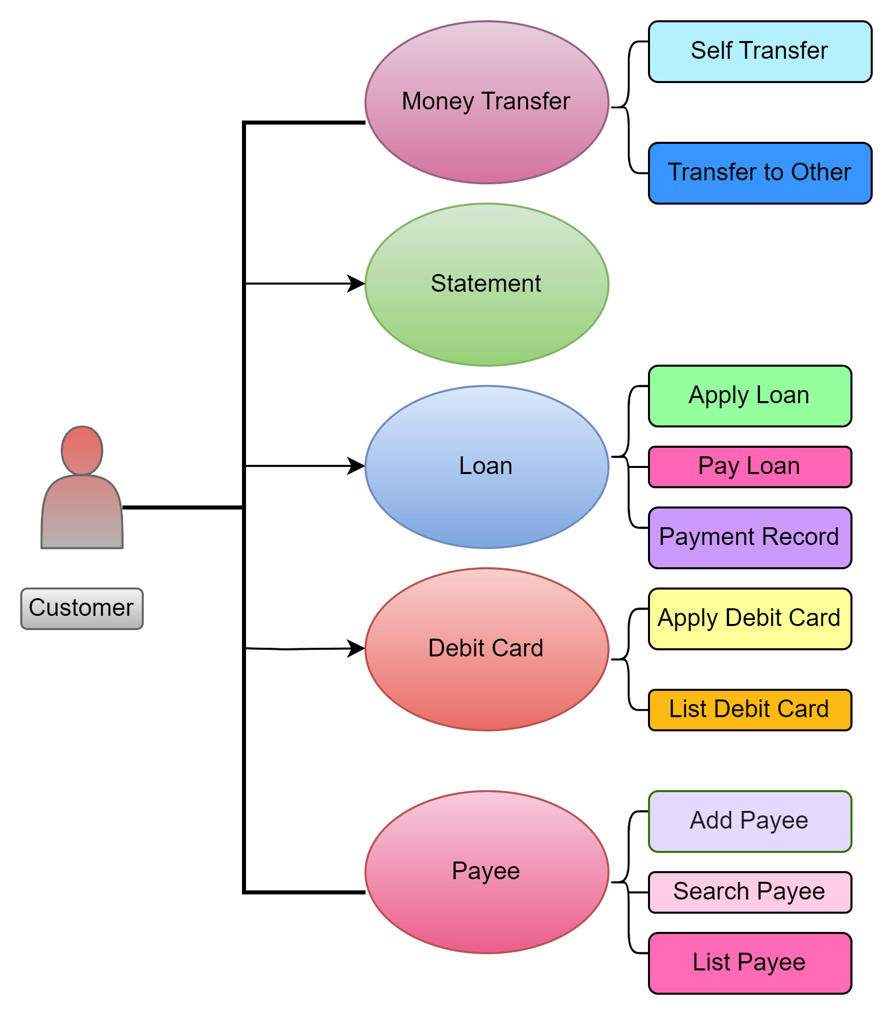
Use Case Diagram (Customer):

Slide 8
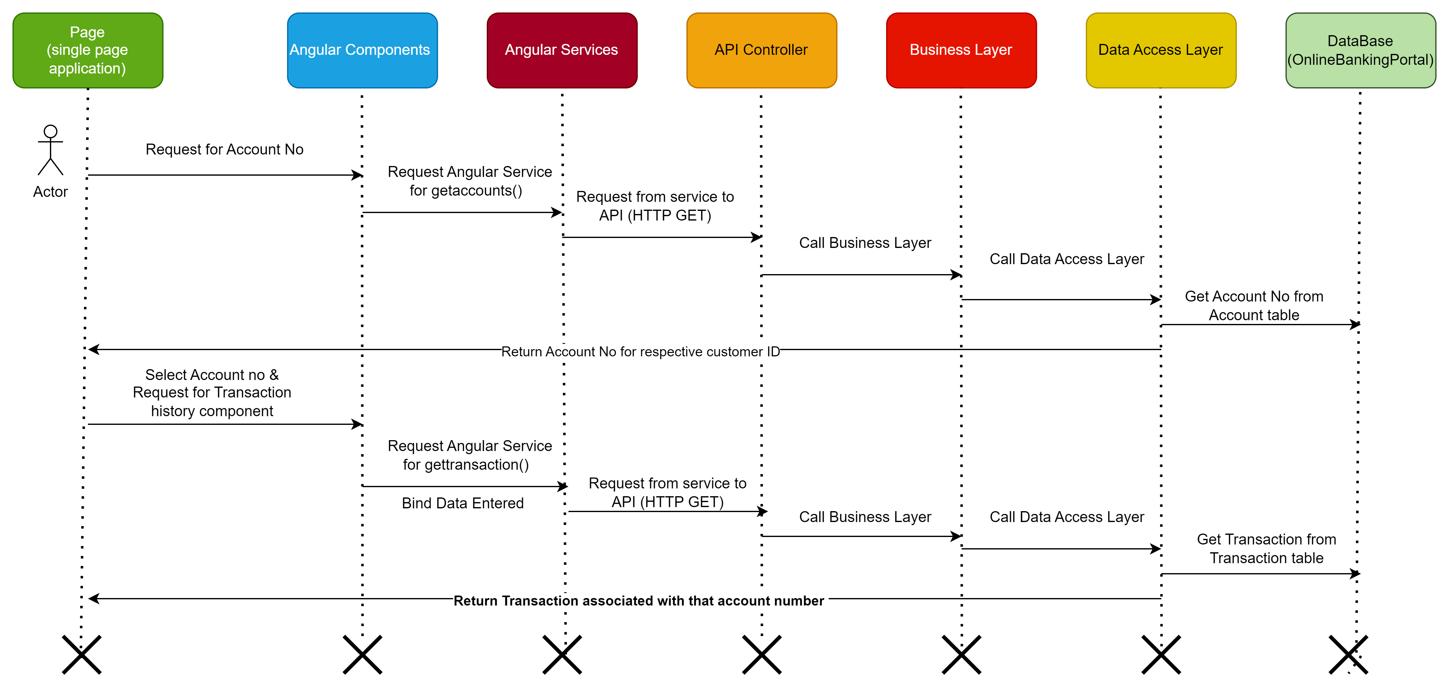
Sequence Diagram (admin):
Fig : Sequence Diagram for Fetching Transaction History

Slide 9
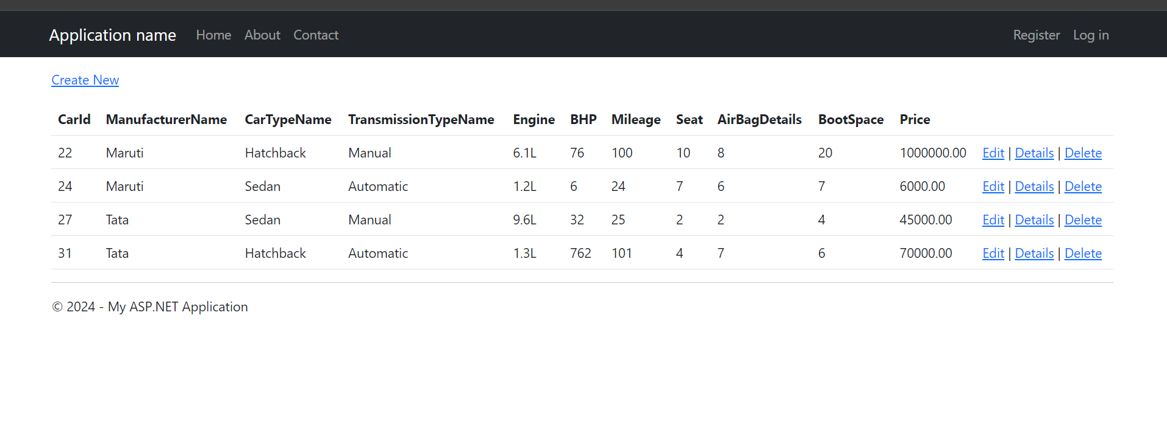
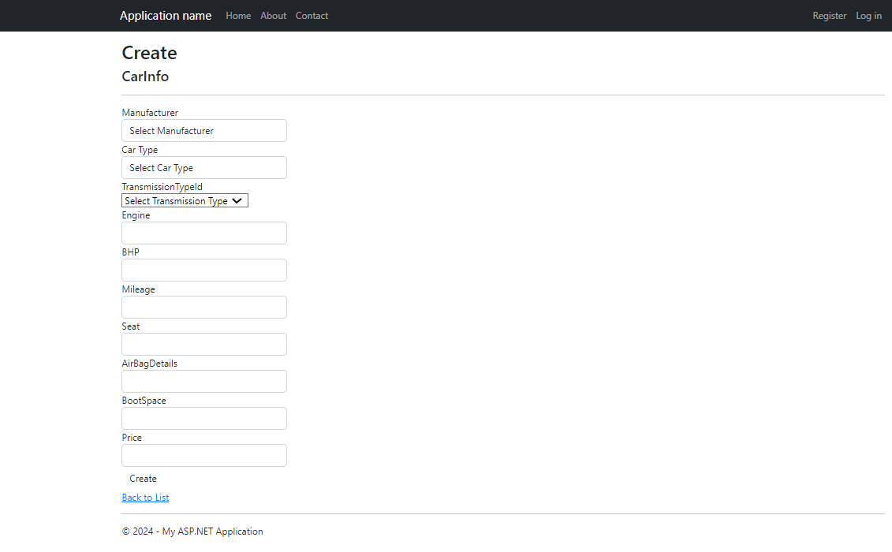
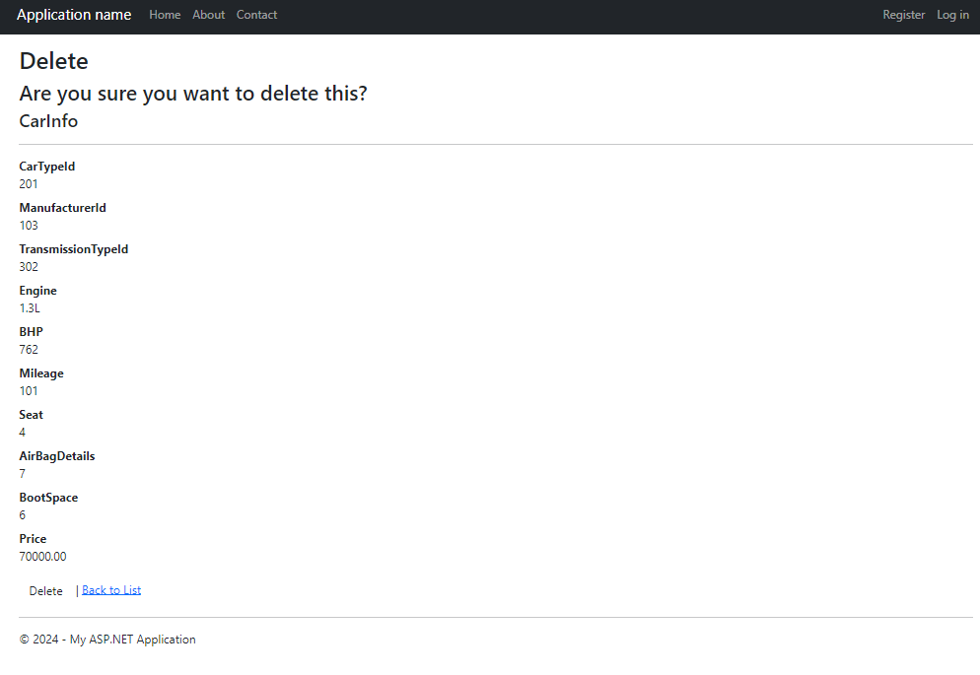
OUTPUT SNIPPET
Fig: List Car View
Fig: Create Car View
Fig: Edit Car View
Fig: Delete Car View

Slide 10

Thank you

